Slide 1
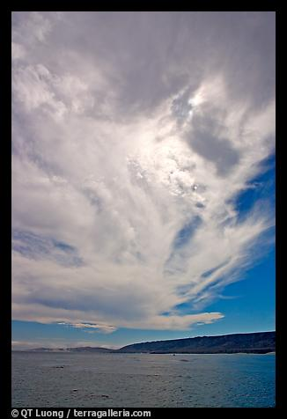
Across to Santa Rosa Island
Notes:
From Santa Cruz we travel across the 5-mile channel to Santa Rosa Island.

Slide 2
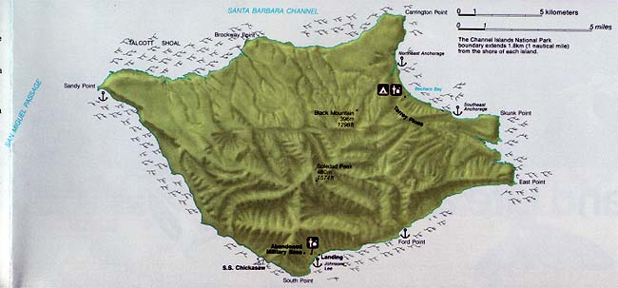
SANTA ROSA
Notes:
Santa Rosa is the second largest of California's eight Channel Islands.

Slide 3
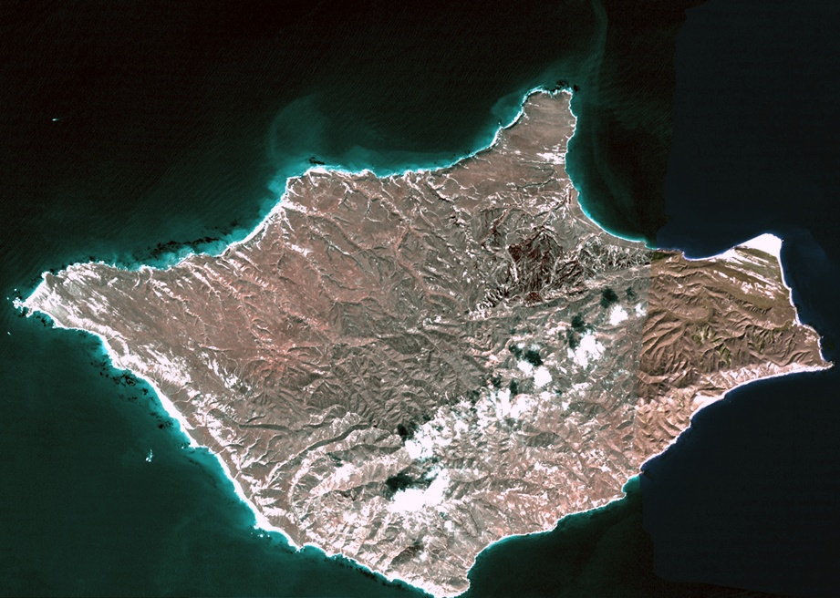
Notes:
Unlike any other Northern Channel Island, Santa Rosa Island is blanketed predominantly with gentle rolling hills and grasslands. High mountains with deeply cut canyons are limited. The northeastern shore consists of well developed marine terraces where cliffs abut the ocean. The southern sector of the island is steeper and more rugged. The island's coastline is quite variable, with broad sandy beaches on the northwest, northeast and southwest.

Slide 4
Notes:
The structure of Santa Rosa Island is similar to that of Santa Cruz Island - an uplifted block deformed by folding and faulting. However, Santa Rosa has a larger area of Tertiary sedimentary rocks than any other Channel Island. Tertiary sandstones, siltstones, shales and volcanics on the northern half of the island are covered with a thick layer of Quaternary (Pleistocene Era) deposits. The oldest rocks are on the south side - …

Slide 5
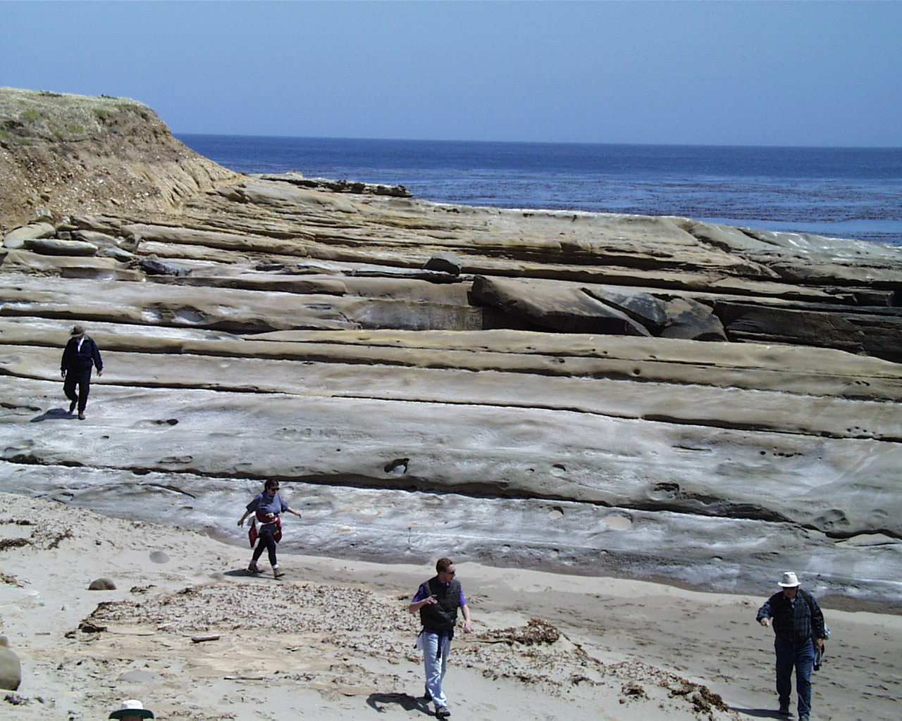
Eocene South Point Fm.
Notes:
… a complex series of Eocene, …

Slide 6
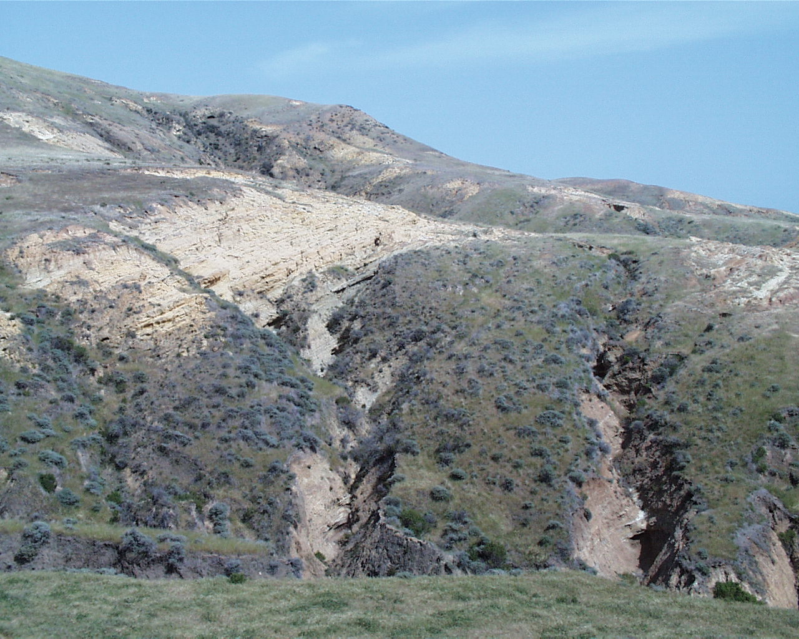
Oligocene Sespe Fm.
Notes:
… Oligocene …

Slide 7
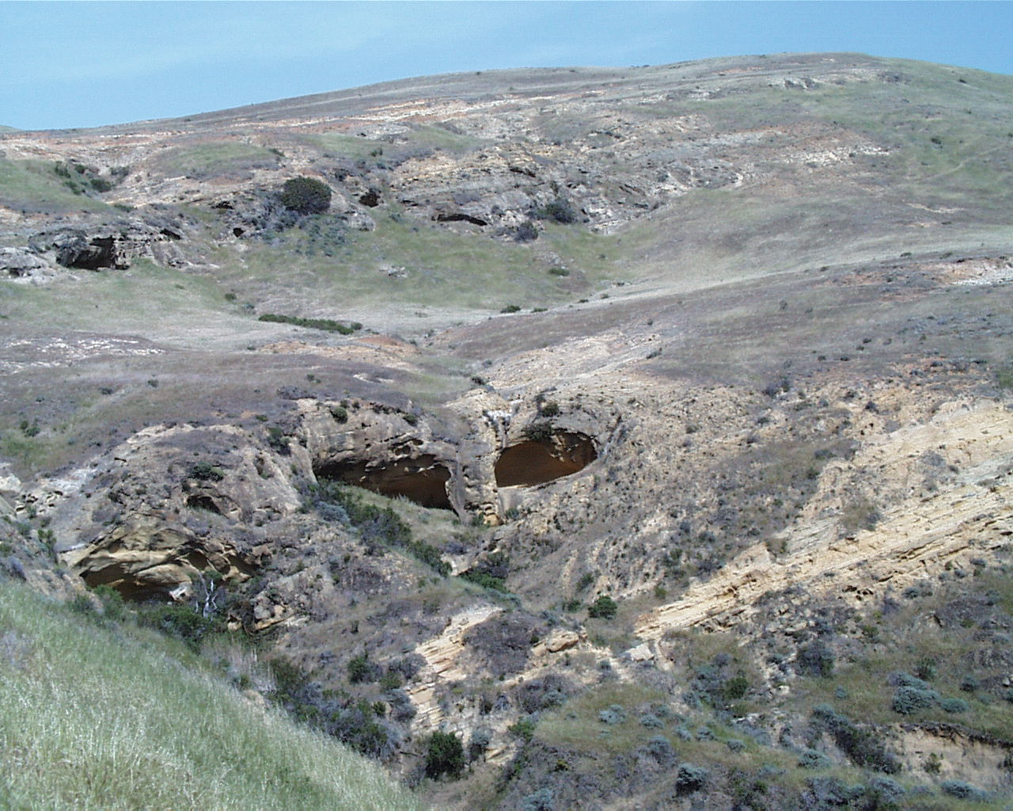
Late Oligocene to Earliest Miocene Vaqueros Sandstone
Notes:
… and Earliest Miocene sedimentary rocks …

Slide 8
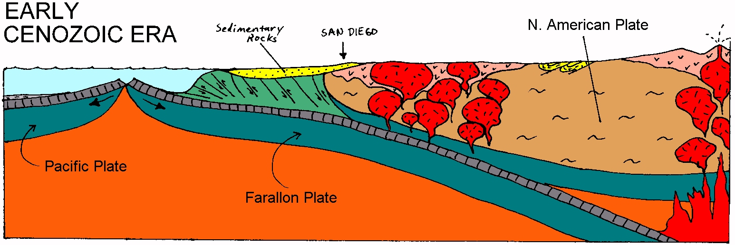
EPR approaches, forearc basin becomes more terrestrial
Notes:
… that like those on Santa Cruz Island reflect deposition in a forearc basin that in generally evolves from deep water marine to shallow marine and terrestrial sedimentation through time. Of particular interest are the Eocene conglomerates on Santa Rosa …

Slide 9
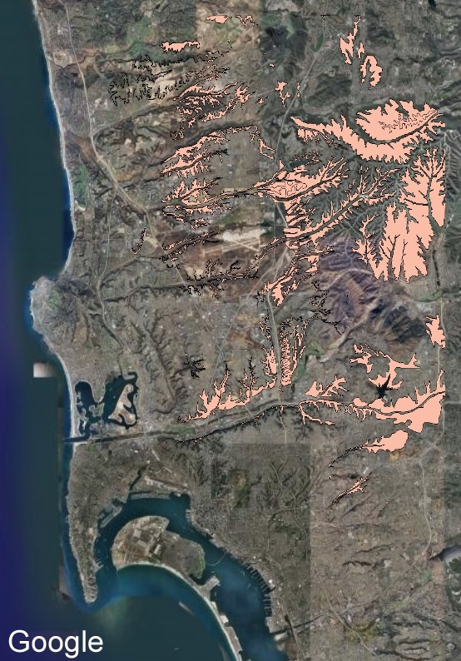
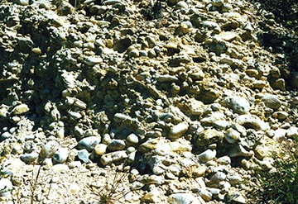
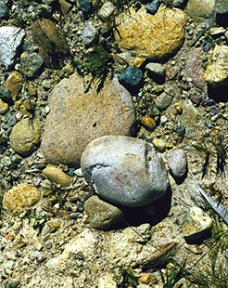
“Poway” Conglomerates in San Diego
Notes:
… which are equivalent to the widespread “Poway” Conglomerates in San Diego.

Slide 10
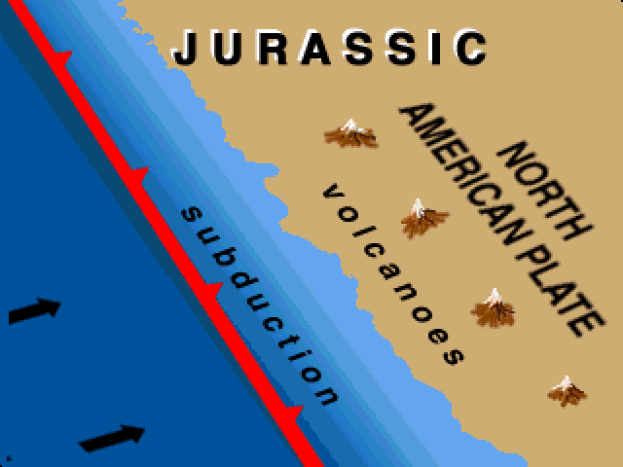
Notes:
Poway Conglomerates are derived from a volcanic source region in Northern Sonora Mexico. Those volcanoes eroded in the Eocene, generating vast quantities of rounded rock fragments that were carried west by a major river system and deposited in a large fan-delta. Displacement along right-lateral strike-slip faults segmented the once continuous conglomerate mass and transported the western portions far to the north where they outcrop today on Santa Rosa and San Miguel Islands.

Slide 11
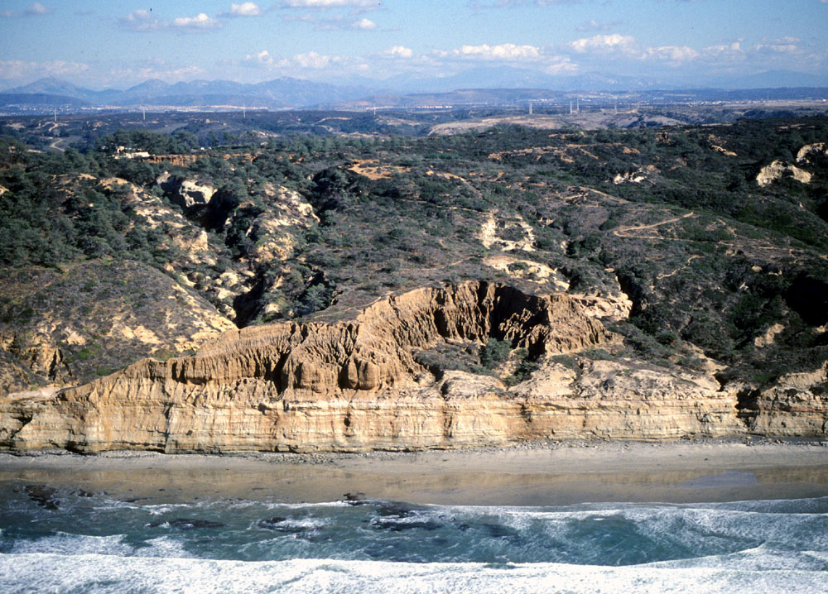
Torrey Pines State Reserve
Notes:
Torrey pines also made the tectonic journey from San Diego to Santa Rosa Island. It is the rarest species of pine in North America. Only two native stands exist, both of which are very small and contain only a few thousand trees. One is at Torrey Pines State Reserve in San Diego …

Slide 12
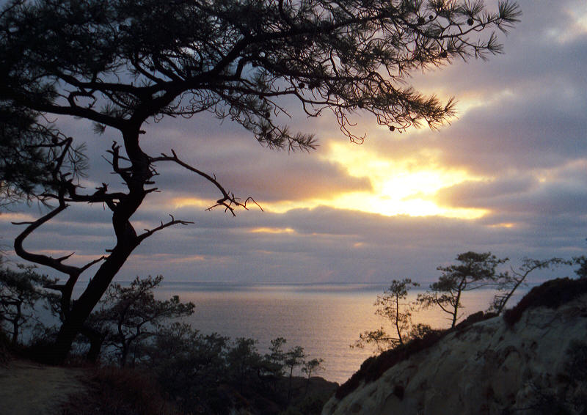
Torrey pines, San Diego
Notes:
... which was set aside to protect the Torrey pine.

Slide 13
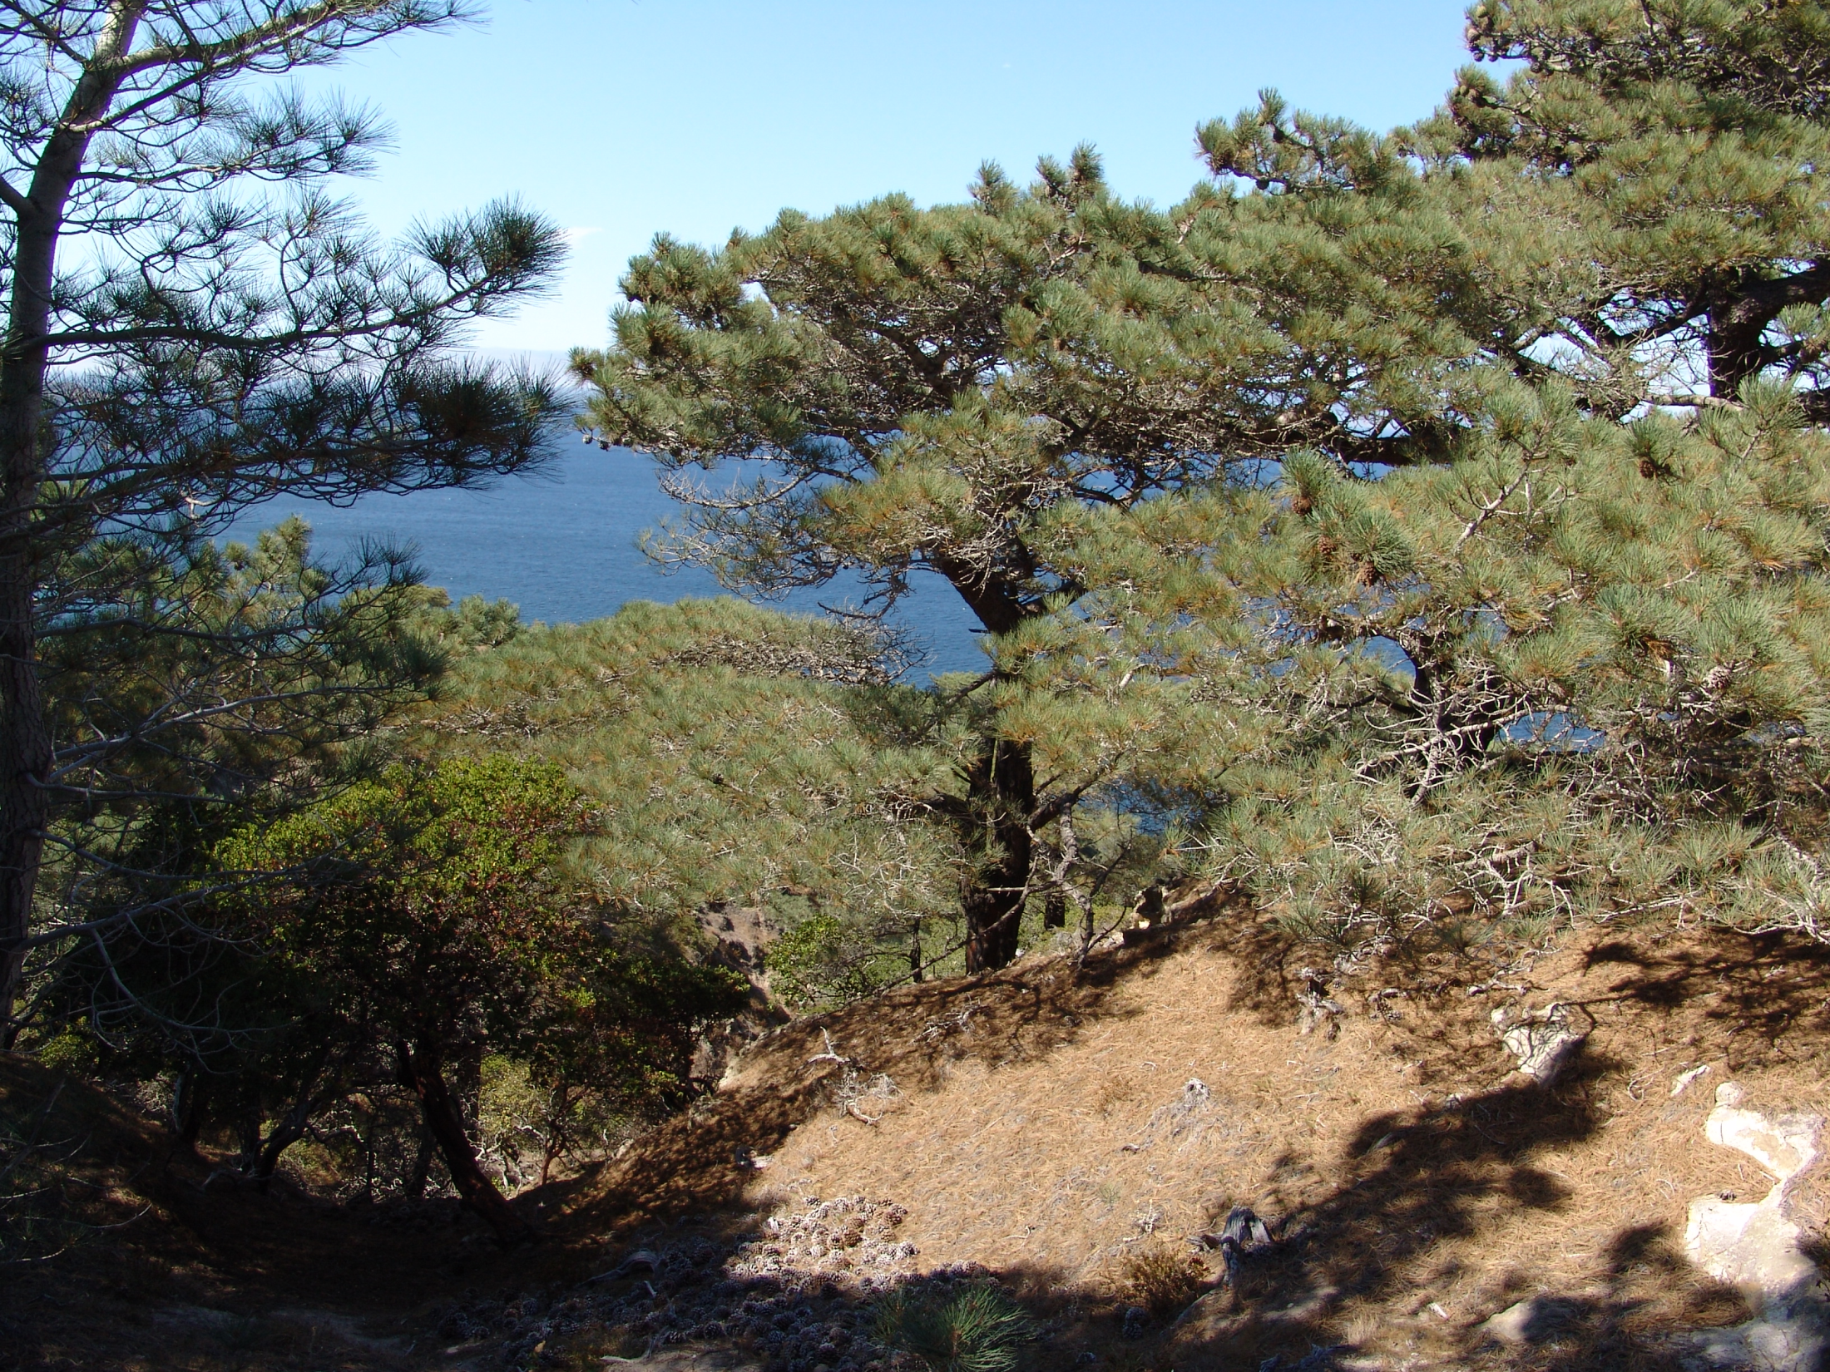
Torrey pines on Santa Rosa Island
Notes:
And the other lies on Santa Rosa Island.

Slide 14
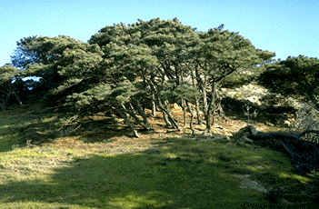
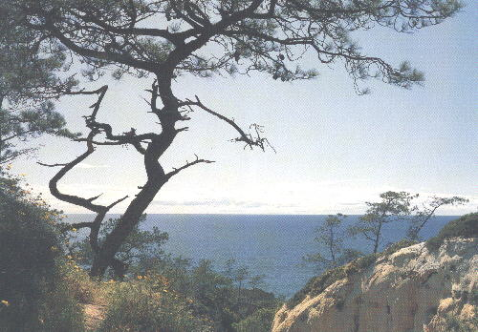
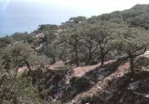
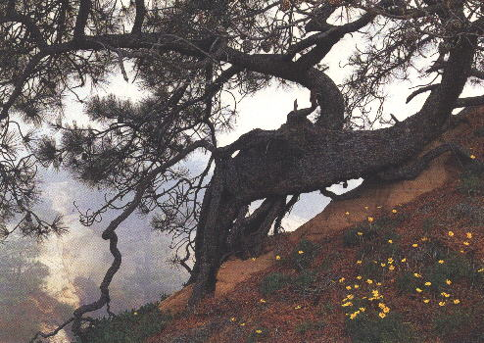
Santa Rosa Island
San Diego
Notes:
Although some consider the Santa Rosa trees to be a sub-species of those found in San Diego, there is little doubt both originated from common mainland ancestors. Torrey pines are relicts of the Pleistocene flora of California. This relict flora has apparently been pushed to the brink of extinction by climatic changes over the past 10,000 years and has only been able to survive in these two limited areas where coastal fog and other factors provided a suitable habitat. Before we climb any further out on this biological limb (even though it’s attached to the geologically-cool Torrey pine!) we need to get back to the sedimentary record.

Slide 15
Late Oligocene to Earliest Miocene Vaqueros Sandstone
Notes:
We left off with forearc basin sedimentation during the Eocene, Oligocene and Earliest Miocene.

Slide 16
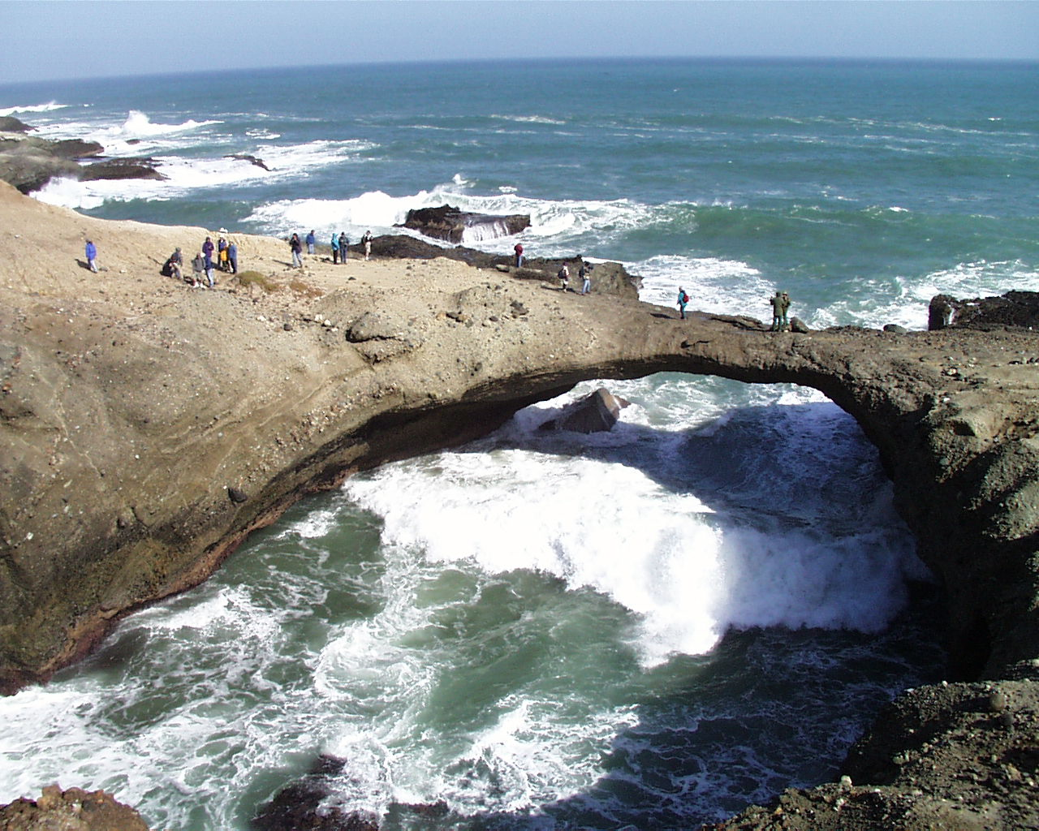
Sea arch in Miocene San Onofre Breccia
Notes:
Just like on Santa Cruz Island, the transition to deposition in transtensional basins on Santa Rosa Island is marked by the San Onofre Breccia. At Carrington Point, on the east end of Santa Rosa, a beautiful sea arch is carved into the San Onofre Breccia. Above the San Onofre Breccia lies ….

Slide 17
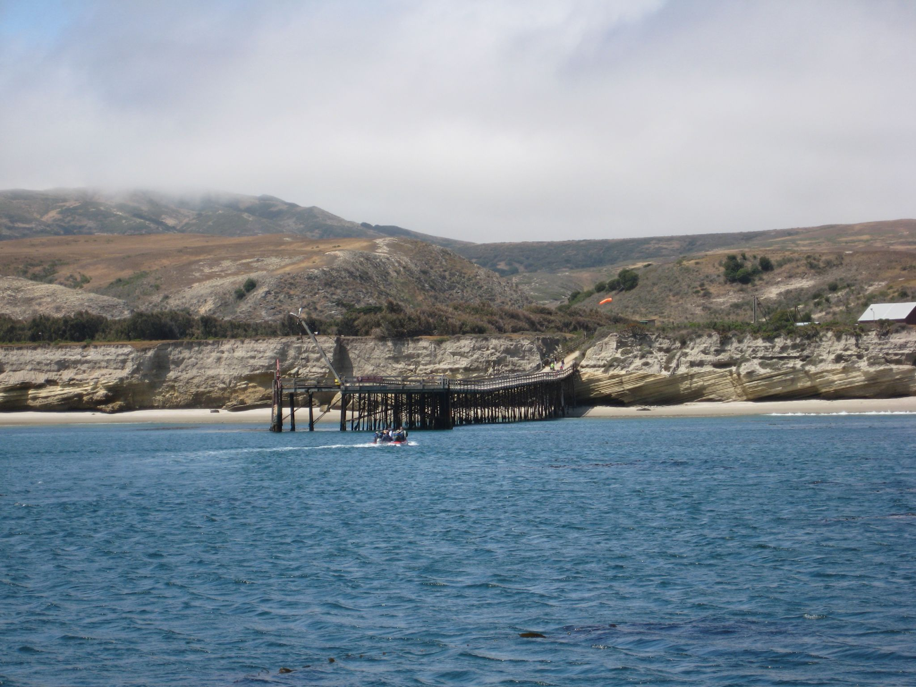
Beechers Bay
Notes:
… the Beechers Bay Member of the Monterey Formation. Named after the bay where the island’s only landing is built, …

Slide 18
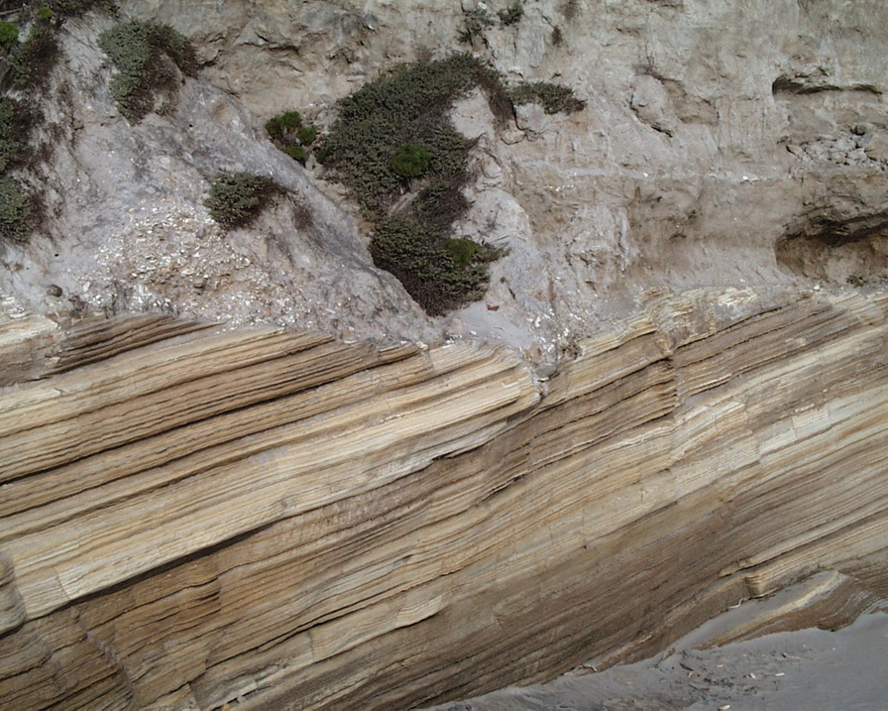
Pleistocene marine terrace deposits
Miocene Beechers Bay Member
Notes:
…this unit is the first rock visitors notice when they arrive on the island. The angular unconformity it makes with the overlying Pleistocene marine terrace deposits could not be more obvious,

Slide 19
Pleistocene marine terrace deposits
wave cut platform
Miocene Beechers Bay Member
Notes:
… and represents deposition on top of a wave cut platform …

Slide 20
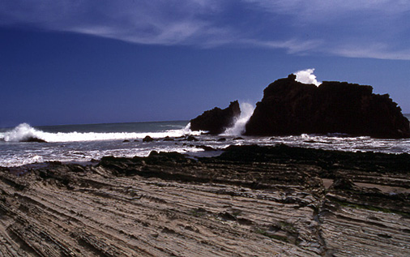
Near Point, Santa Cruz Island
wave cut platform
Notes:
… similar to the one we saw at Neat Point on Santa Cruz Island.

Slide 21
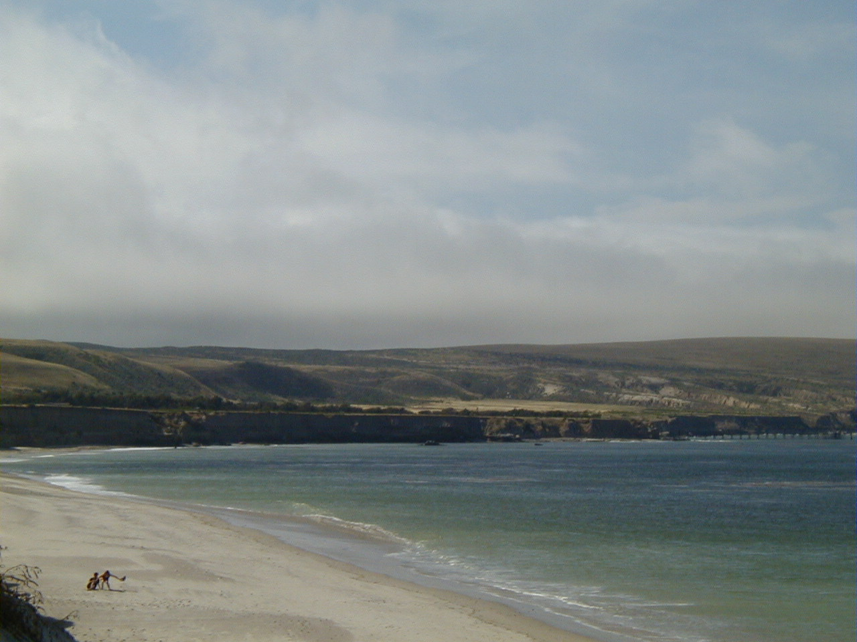
Beechers Bay
Notes:
Above the cliff at Beechers Bay …

Slide 22
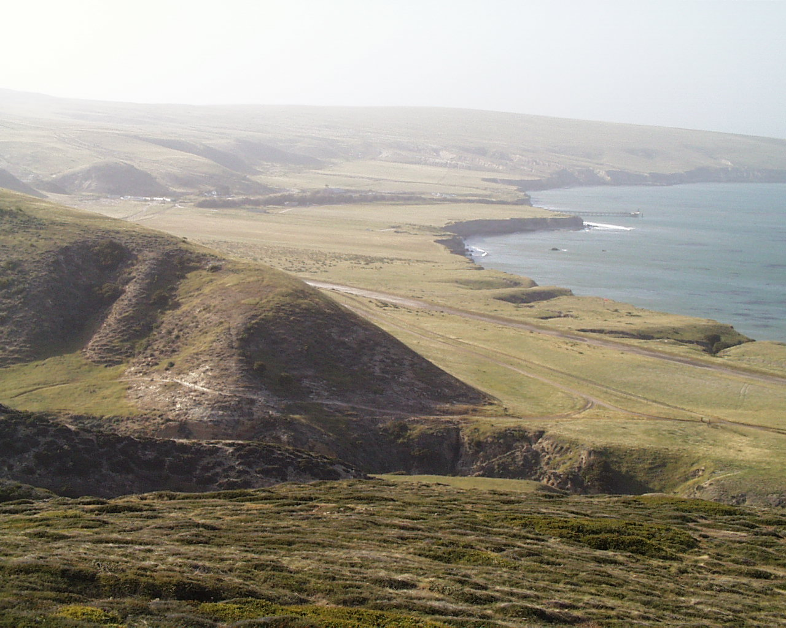
Marine Terrace
Notes:
… lies a broad marine terrace. The great width of this terrace indicates that it is relatively young. In time it will become narrower as waves erode back the sea cliff. During the Pleistocene ice ages these terraces would have been wider and elevated more than 300 feet above the lower sea levels. Because of the wetter climate, the terraces would have been covered with lush vegetation …

Slide 23
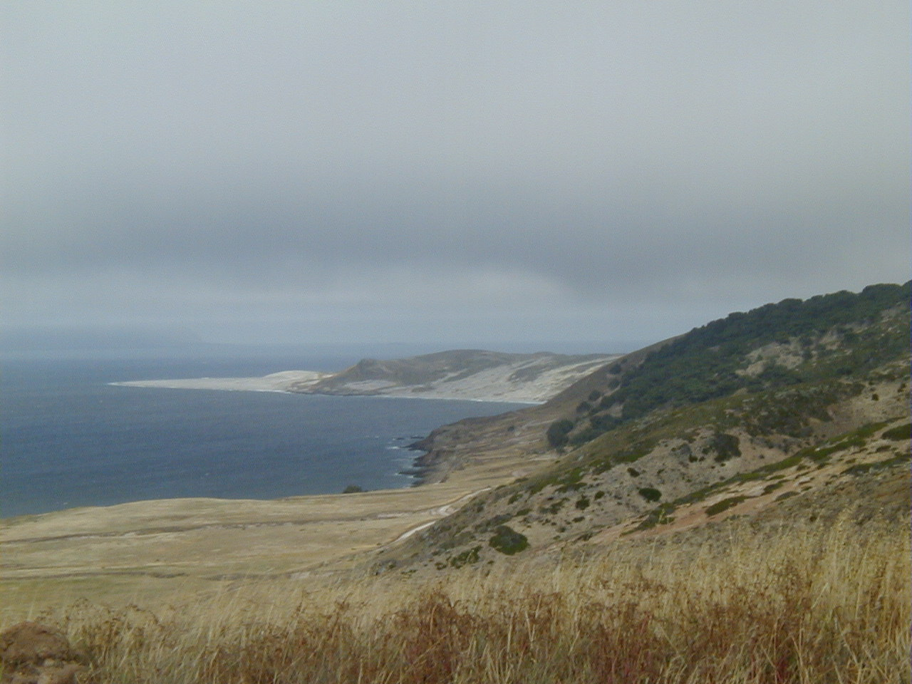
Santa Rosa Island
Notes:
… - the perfect grazing lands for …

Slide 24
Santa Rosa Island
Notes:
… mammoths. The remains of dozens of mammoths have been found buried under the marine terrace deposits of Santa Cruz, Santa Rosa and San Miguel islands, …

Slide 25
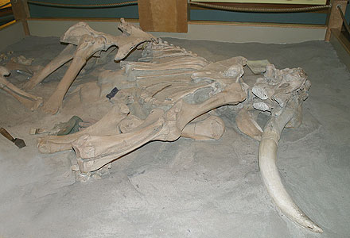
Most complete Pygmy Mammoth skeleton ever found
Notes:
… including this specimen from Santa Rosa. It’s the most complete Pygmy Mammoth skeleton ever found, the only full sized skeleton of the species anywhere in the world, and the first to be dated. Scientists estimate the age at 12,840 years old. The pony-sized species, a distant relative of the modern elephant, is believed to have lived only on San Miguel, Santa Rosa, and Santa Cruz Islands. The story of how mammoths got to the islands goes something like this:

Slide 26
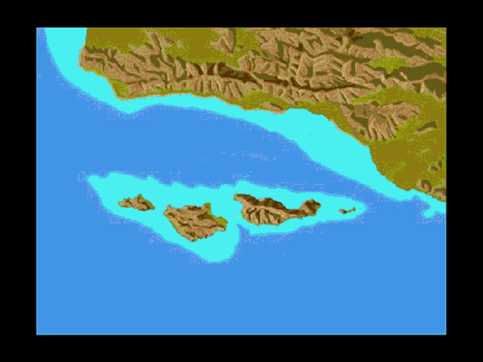
Notes:
During the ice ages sea level to dropped markedly. While sea level was low, the Pygmy Mammoth's ancestors, the giant Columbian Mammoth, swam across the narrow Santa Barbara Channel to Santarosae. When the ice age ended, sea level climbed and filled the channel with water. The distance between the islands and the mainland was too far for the mammoths to swim and some became trapped on the islands. Over time island mammoths evolved into a pygmy form better suited to survival in the limited habitat. Lack of food and steep hills may have been factors in the process.

Slide 27
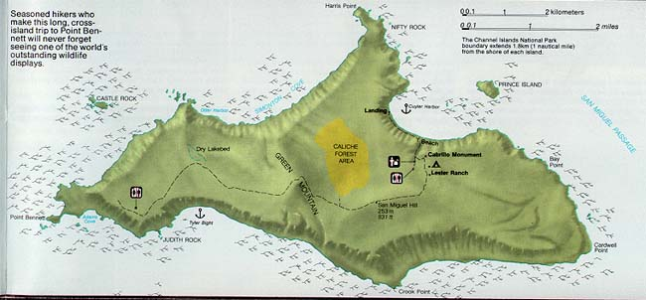
SAN MIGUEL
Notes:
Well are journey to the islands is nearly over. San Miguel Island is our last stop,...

Slide 28
Notes:
and since its geology is similar to that of the rest of Santarosae there is not much here that we haven’t already explained. There is one notable exception.

Slide 29
Notes:
One can’t help but notice white, wind-blown sand that stripes the island.

Slide 30
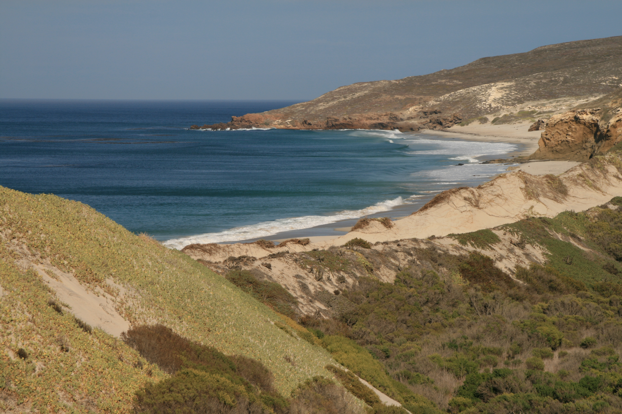
San Miguel Island
Cuyler Harbor
Notes:
Recent and ancient dunes cover so much of the island, that it just as well be named …

Slide 31
Sand Miguel Island
Cuyler Harbor
Notes:
… Sand Miguel!

Slide 32
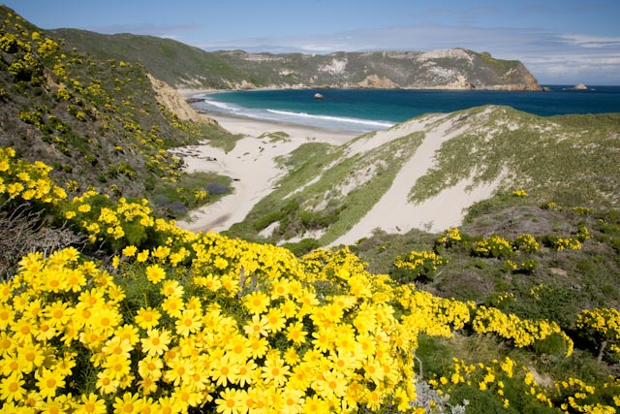
Notes:
One has to ask: Where did all this sand come from? Since most of the dunes are Holocene in age, that pretty much means we are going to have to use present-day processes to explain their origin.

Slide 33
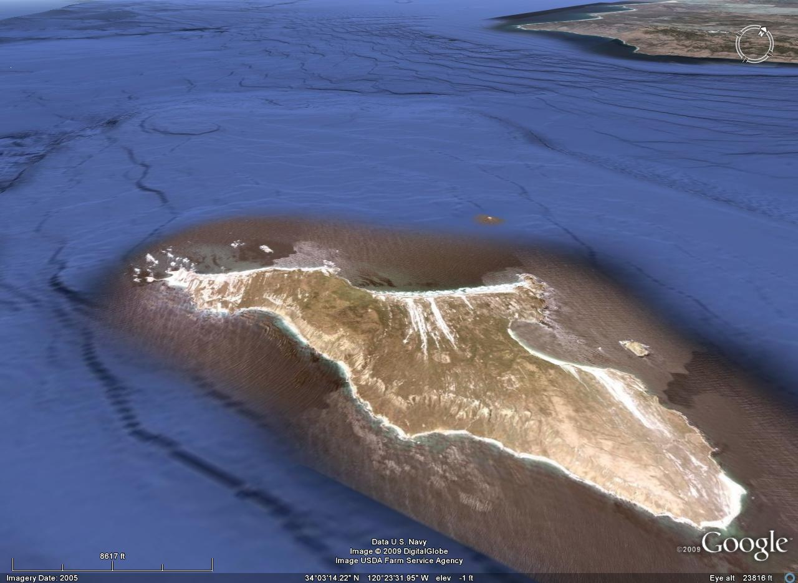
Notes:
Several factors contribute to dune formation on San Miguel Island. Most important of these is that, as the most westerly of the northern Channel Islands, ….

Slide 34
Strong wind and waves
Notes:
…. San Miguel is exposed to the strongest winds and largest waves.

Slide 35
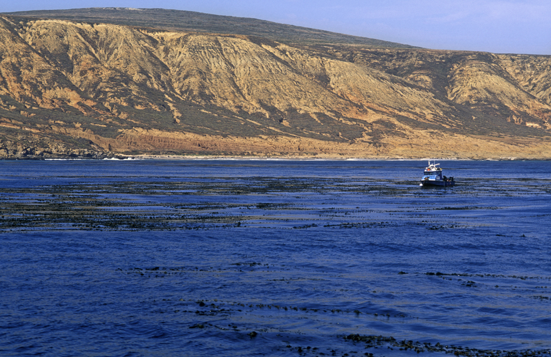
San Miguel Island
Notes:
Those waves erode the relatively soft sedimentary rocks of the island and grind them down into sand.

Slide 36
Level shelf
Notes:
The fairly level shelf which borders the island on its windward side keeps the sand from draining off into deep water …

Slide 37
Miocene volcanics
Notes:
… while ridges of more erosion-resistant sedimentary and volcanic rock prevent wave action from transporting the sand around the island to its leeward side.

Slide 38
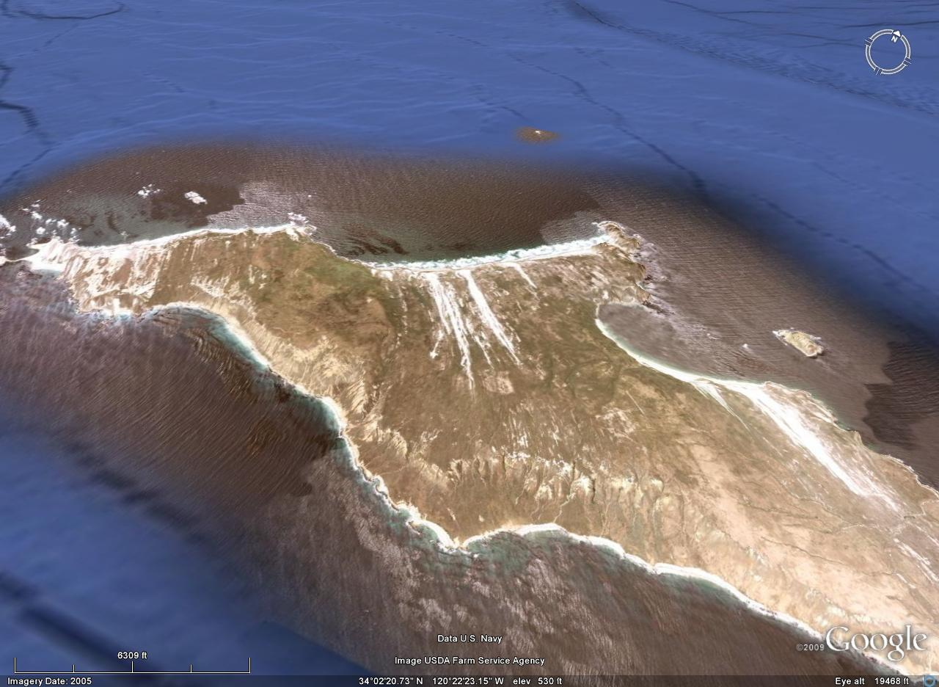
Sand trapped
Sand trapped
Notes:
The wave eroded sand is effectively trapped on the long windward beaches where only the strong winds can carry it away.

Slide 39
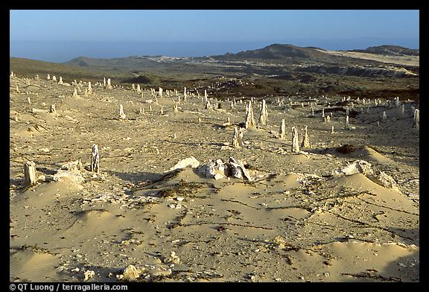
Caliche Forest
Notes:
In the center of the island the strong winds have eroded some of the older dunes to expose a strange landscape known as the Caliche Forest. Caliche is a porous form of calcium carbonate often mixed with soil, or in this case sand. It is formed by capillary action (wicking) that draws mineral-rich ground water to the surface, where it evaporates in the wind and sun, leaving the minerals.

Slide 40
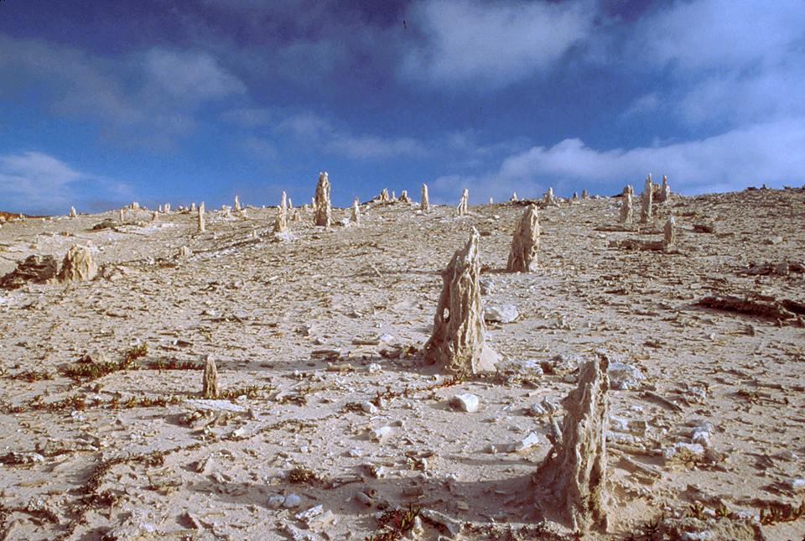
Notes:
The calcified casts of ancient plants represent sand smothered vegetation from a lush late Pleistocene woodland. Trees are not the only thing buried under all that sand.

Slide 41
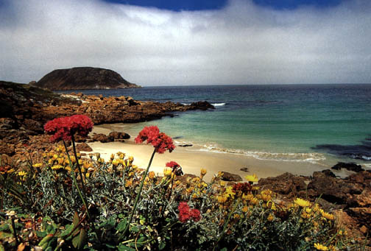
Notes:
With more than 500 Indian sites scattered across the island, San Miguel has probably the richest archeological record of all the Channel Islands.

